Slide 1
M Tech(Data Science & Engineering) Introduction to Statistical Methods
Dr YVK Ravi Kumar

Slide 2
Session No 2

Slide 3
Agenda
Experiments, Counting Rules, and Assigning Probabilities
Events and Their Probability
Some Basic Relationships of Probability
Conditional Probability
Bayes’ Theorem

Slide 4
Probability
Probability refers to the study of randomness and uncertainty.
The language of probability is used in informal manner in normal circumstances.
The methodology of probability will enable us to express in precise language such informal statements.

Slide 5
Random Experiment
Term "random experiment" is used to describe any action whose outcome is not known in advance. Here are some examples of experiments dealing with statistical data:
Tossing a coin
Counting how many times a certain word or a combination of words appears in the text of the “King Lear” or in a text of Confucius
counting occurrences of a certain combination of amino acids in a protein database.
pulling a card from the deck

Slide 6
Sample spaces, sample sets and events
The sample space of a random experiment is a set S that includes all possible outcomes of the experiment.
For example, if the experiment is to throw a die and record the outcome, the sample space is S = { 1,2,3,4,5,6}
Qn-
What is the sample space if the experiment is ‘throwing a die twice’? (it will be pairs , better to represent in alphabets, A to F and then write as AA,AB, AC….EE – How many events?

Slide 7



Discrete sample spaces.
Continuous sample spaces

Slide 8
Event
An event is a set of outcomes of the experiment. This includes the null (empty) set of outcomes and the set of all outcomes. Each time the experiment is run, a given event A either occurs, if the outcome of the experiment is an element of A, or does not occur, if the outcome of the experiment is not an element of A.

Slide 9
Complement of an Event
The complement of event A is defined to be the event consisting of all sample points that are not in A.
The complement of A is denoted by A^{c}.
The Venn diagram below illustrates the concept of a complement.
Sample Space S
Event A
A^{c}

Slide 10
Union of Two Events
The union of events A and B is the event containing all sample points that are in A or B or both.
The union is denoted by A  B
The union of A and B is illustrated below.
Sample Space S
Event A
Event B

Slide 11
Intersection of Two Events
The intersection of events A and B is the set of all sample points that are in both A and B.
The intersection of A and B is the area of overlap in the illustration below.
Sample Space S
Intersection
Event A
Event B

Slide 12
Mutually Exclusive Events
Two events are said to be mutually exclusive if the events have no sample points in common. That is, two events are mutually exclusive if, when one event occurs, the other cannot occur.
Sample
Space S
Event A
Event B

Slide 13
Independent & Dependent
Events are either
independent (the occurrence of one event has no effect on the probability of occurrence of the other) or
dependent (the occurrence of one event gives information about the occurrence of the other)

Slide 14















Slide 15
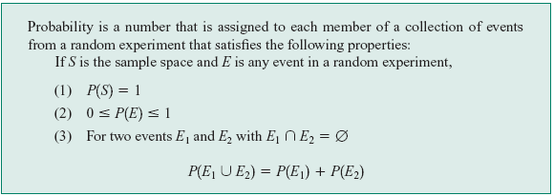
Axioms of Probability

Slide 16





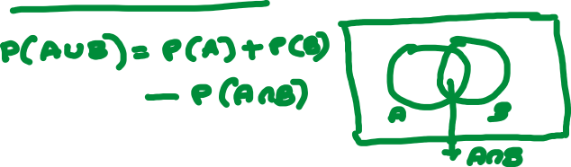



Slide 17
Probability as a Numerical Measure of the Likelihood of Occurrence
Increasing Likelihood of Occurrence
0
.5
1
Probability:
The occurrence of the event is
just as likely as it is unlikely.

Slide 18



1
The sales manager of an e commerce company says that 80% of those who visit their website for the first time do not buy any mobile. If a new customer visits the website, what is the probability that the customer would buy mobile

Slide 19
2
 | Blue | Black | Brown | Total
Software prog | 35 | 25 | 20 | 80
Project Mgrs | 7 | 8 | 5 | 20
Total | 42 | 33 | 25 | 100
If an employee is selected at random,what is the probability that he is a software prog? If an employee is selected at random,what is the probability that he is wearing a blue trouser

Slide 20
3
A Survey conducted by a bank revealed that 40% of the accounts are savings accounts and 35% of the accounts are current accounts and the balance are loan accounts.
What is the probability that an account taken at random is a loan account ?
What is the probability that an account taken at random is NOT savings account ?
What is the probability that an account taken at random is NOT a current account
What is the probability that an account taken at random is a current account or a loan account?

Slide 21
4
In a certain residential hub,60% of all households get internet service from the local cable company,80% get the television service from that company, and 50% get both services from that company.
If a household is randomly selected, what is the probability that it gets at least one of these two services from the company, and what is the probability that it gets exactly one of these services from the company?

Slide 22


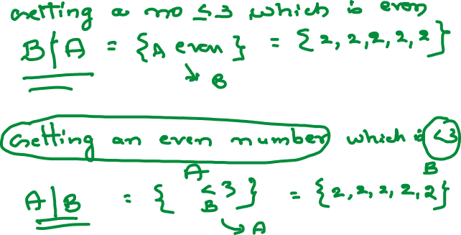



Slide 23
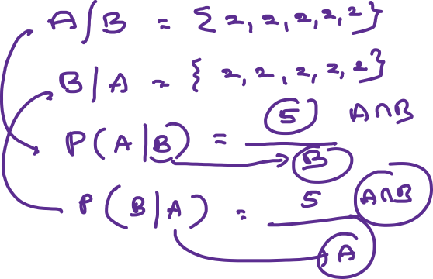

Slide 24




Conditional Probability
The probability of event B given that event A has occurred P(B|A) or, the probability of event A given that event B has occurred P(A|B)

Slide 25












Conditional Probability
The probability of event B given that event A has occurred P(B|A) or, the probability of event A given that event B has occurred P(A|B)

Slide 26





5
Toss a six-sided die twice. The sample space consists of all ordered pairs (i; j) of the numbers 1; 2; : : : ; 6, that is, S = {(1; 1); (1; 2); : : : ; (6; 6)}.. Let A = {outcomes match}
and B = {sum of outcomes at least 8}.
Then find P(A),P(B),P(A/B) and P(B/A)

Slide 27




5
Toss a six-sided die twice. The sample space consists of all ordered pairs (i; j) of the numbers 1; 2; : : : ; 6, that is, S = {(1; 1); (1; 2); : : : ; (6; 6)}.. Let A = {outcomes match}
and B = {sum of outcomes at least 8}.
Then find P(A),P(B),P(A/B) and P(B/A)

Slide 28
Bayes’ Theorem
To find the posterior probability that event A_{i} will occur given that event B has occurred we apply Bayes’ theorem.
Bayes’ theorem is applicable when the events for which we want to compute posterior probabilities are mutually exclusive and their union is the entire sample space.

Slide 29
6
Three persons A,B and C are competing for the post of CEO of a company. The chances of they becoming CEO are 0.2,0.3 and 0.4 respectively.
The chances of they taking employees beneficial decisions are 0.50,0.45 and 0.6 respectively
What are the chances of having employees beneficial decisions after having new CEO

Slide 30










6
Three persons A,B and C are competing for the post of CEO of a company. The chances of they becoming CEO are 0.2,0.3 and 0.4 respectively.
The chances of they taking employees beneficial decisions are 0.50,0.45 and 0.6 respectively
What are the chances of having employees beneficial decisions after having new CEO

Slide 31




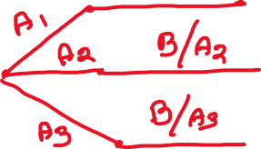







Slide 32
7
Three persons A,B and C are competing for the post of CEO of a company. The chances of they becoming CEO are 0.2,0.3 and 0.4 respectively.
The chances of they taking employees beneficial decisions are 0.50,0.45 and 0.6 respectively
After having new CEO,employees got benefits, what is the probability that this is because of A ?

Slide 33
8
An individual has 3 different mail accounts. Most of her messages, in fact 70% come into account #1,whereas 20% come into account #2 and the remaining 10% into account #3. Of the messages into account #1, only 1% are spam where as the corresponding for accounts # 2 and # 3 are 2% and 5% respectively.
What is the probability that a randomly selected message is spam?

Slide 34




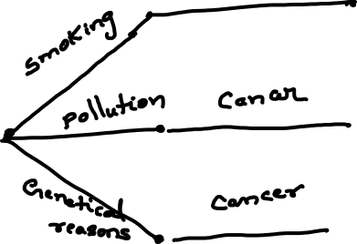



Slide 35


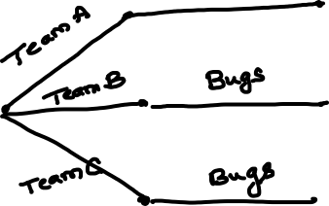








Slide 36

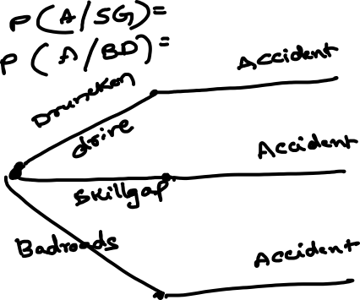







Slide 37













Slide 38

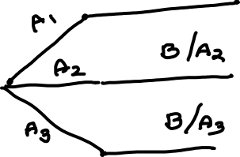



Slide 39
Thanks

